Slide 1
Bantry
Datathon for Social Good Submission

Slide 2
1.
Introduction
Setting the scene and getting to know the data

Slide 3
Introduction
Having carried out initial discovery work during the weekend Datathon session, we identified the following business needs and values that would guide our work:
Understand what “typical” Hubs look like
Identify Hubs that fall outside this typical range
Focus on community engagement
Internal - participation rates (adults / children), programs run
External - Service Referrals

Slide 4
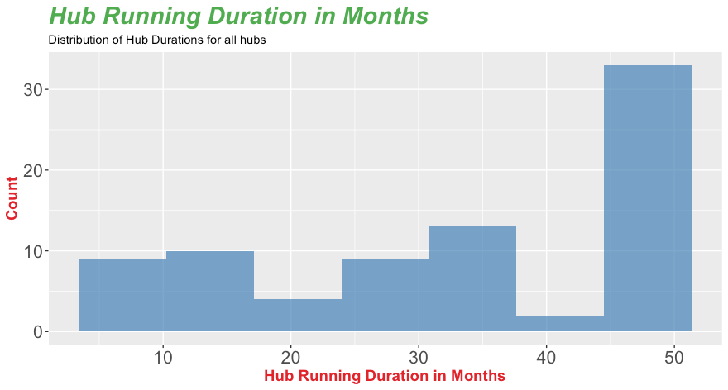
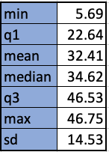
A few details about our approach
Given that hubs have been running for different lengths of time, we chose to standardise our comparisons between hubs by expressing the data as either per-month or per-program-activity averages.
Notes:
Speaking Notes:
We looked at the first and last activity dates for each hub to determine the length the Hub Running Duration.
Given that the shortest a hub has been running been running for is just under 6 months and that about the 1st quartile (the shortest quarter of Hub Running times) is just under 2 years. We have chosen to use a per months time frame to level the playing field between comparisons.
When outcomes of Program Activities are of relevance, instead of standardising on time, we will also look at at Per Program Activities average.

Slide 5
A few more details about the data
We also removed the following from the data to clean it up:
Programmed Activities if they had 0 participants in total (aggregating both child and adult).
Service Referrals that were labelled “number of families participating in the Hub”, “Children” and “Adults”
As an important measure of success was community engagement, our analysis focuses on attendance, programmed activities (which both indicate internal engagement) and service referrals (which indicate external engagement).
Finally, when identifying outliers we used the 1.5*IQR rule.
Notes:
Speaking Notes:
We removed Program Activities of 0 participants to allow for fair comparison of programs that were actually run.
We removed SRs with “number of families participating in the Hub”, as this was clearly not a SR but used to capture something different information.

Slide 6
2.
Analysis
What we found out

Slide 7
The Anatomy of Hubs
Programmed Activities
Service Referrals
Education & Training
One-off events
Playgroups
Parents
Lifestyle
English classes
Child literacy
Violence
Preschool
Migrant resources
Maternal child health
Early Intervention
GP/Doctors
Financial counselling
Family support
Emergency aid
Education and Training
CHS
Accommodation
Participants who gained employment
Other
Volunteering
Formal training
Informal training
Community events
Network meetings
Meetings
School events

Slide 8
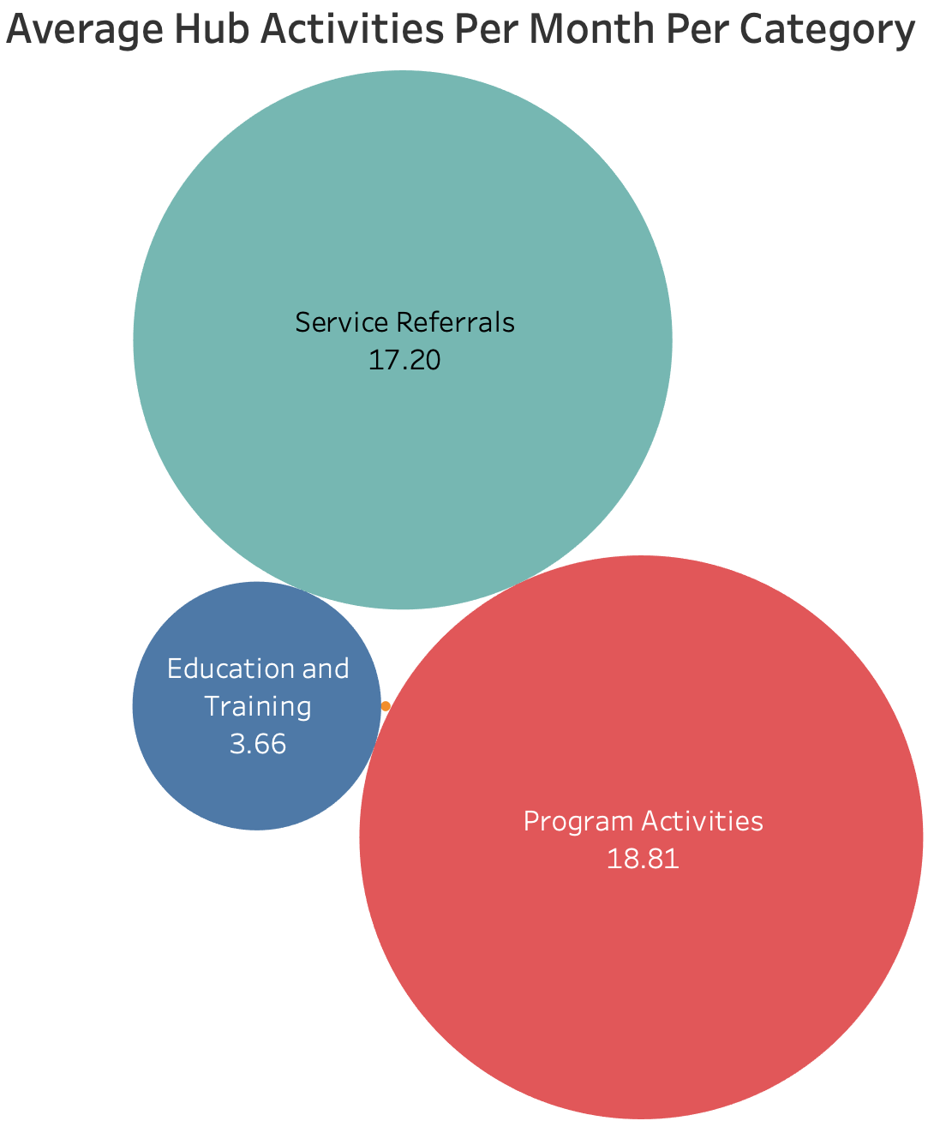
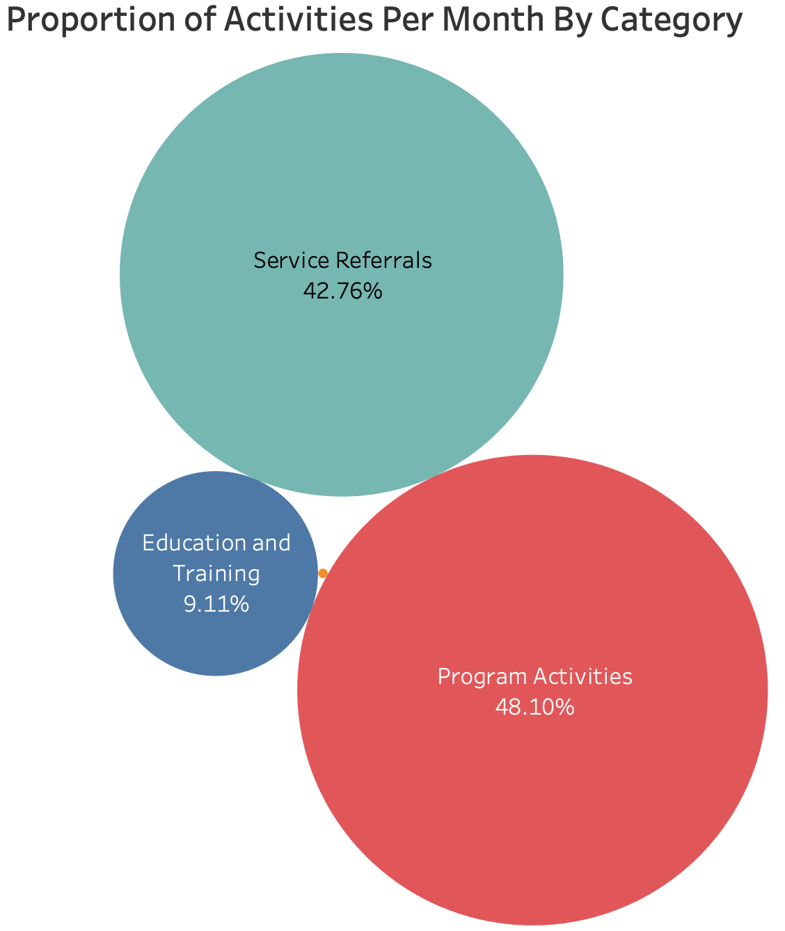
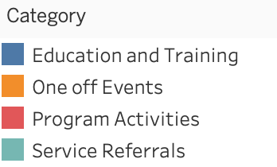
Activities Across CHA
PA
SR
EAT
OOE
This data clearly shows that Program Activities and Service Referrals make up most of the activities each month.
Notes:
Speaking Notes:
Left Bubble Chart:
For each hub we took the average number of activities run each month for each category (EAT,OOE,PA,SR)
We then took an average of that number from all the hubs
The resulting Bubble Chart gives us an indication of the expected number of activities each month by category
Given that EAT and OOE made up a small proportion (and that time was limited) - we exclude them from our analysis.
Right Bubble Chart:
For each hub we took the average number of activities run each month for each category (EAT,OOE,PA,SR)
For each hub we then took the proportion of each category from the sum of all categories to get the proportion of that category.
We then took an average of that number from all the hubs
The resulting Bubble Chart gives us an indication of the expected proportion of activities from that of that category type out of all category types that took place.

Slide 9
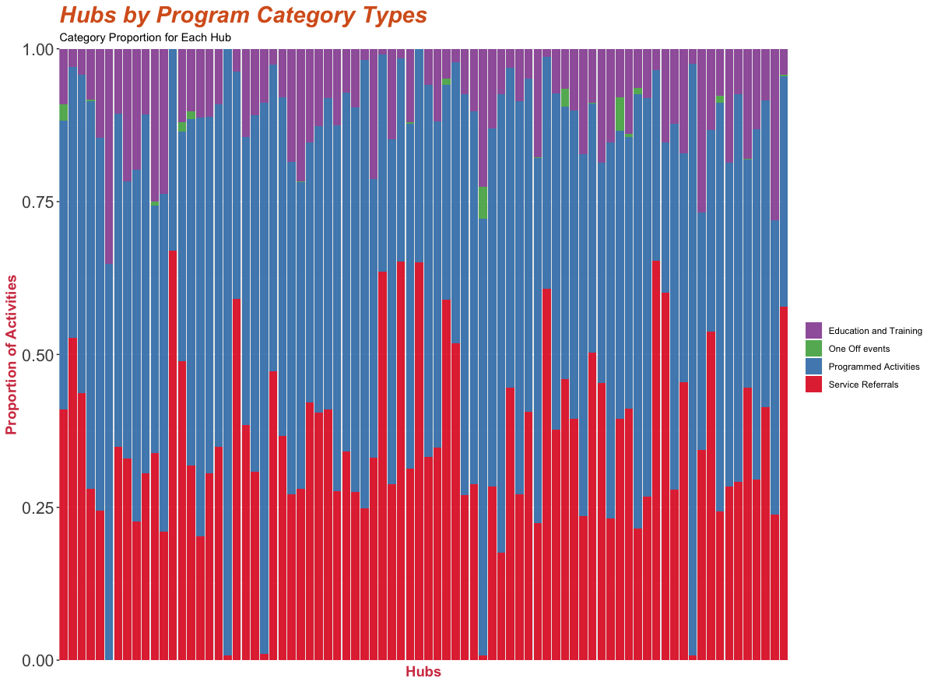
Activities by Hub
PA
PA
The plot below depicts the individual breakdowns of these for each hub by activity category.
SR
SR
Summary
All Hubs offer PAs
But not all hubs have developed partnerships with SRs
While some have a disproportionate number of SRs
EAT and OOE make up a very small proportion of activities. Given this, our analysis now focuses only on PA and SRs
EAT
EAT
OOE
OOE
Notes:
Speakers Notes:
Each vertical line in this plot represents a hub.
The Proportion of Activities indicates the average monthly proportion of activities by category for each hub.
This plot allows us to identify trends and individual outliers.

Slide 10
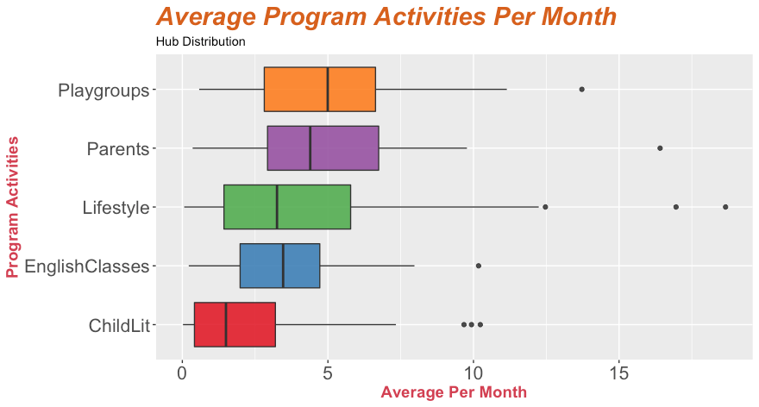
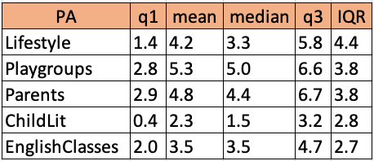
Programmed Activities Run Per Month
PA
PA
Typically a Hub will run 19 Programmed Activities per month.
The following chart shows the average and spread of the number of programs that run each month, broken down by type:
SR
SR
EAT
EAT
There were a number of outliers identified for these sections. Details of these are provided in Ref 1 and 2.
OOE
OOE

Slide 11
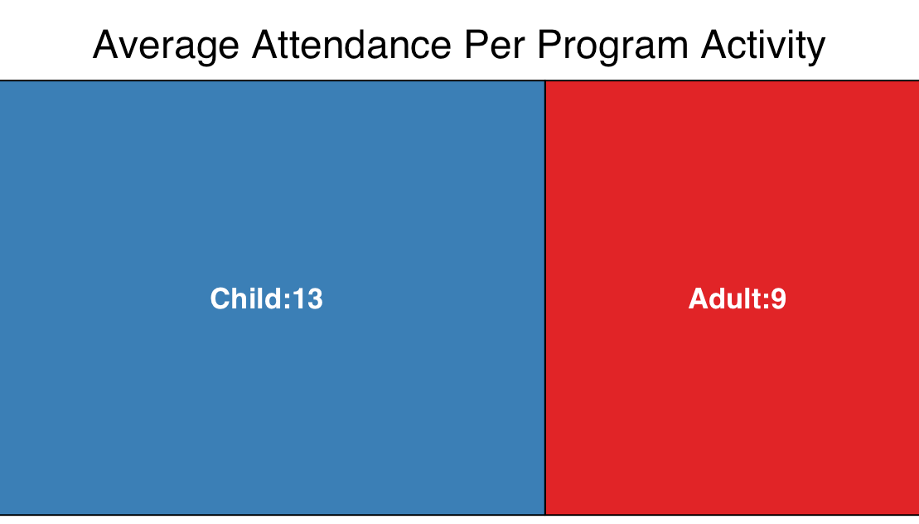
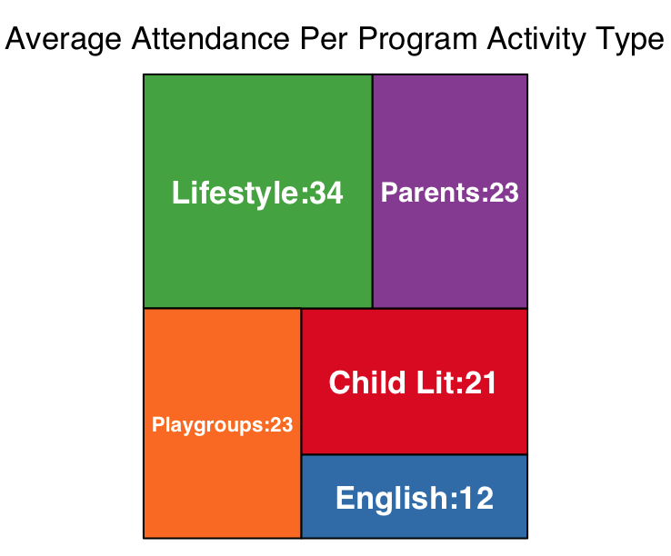
Programmed Activity Attendance
PA
PA
Average attendance looks at the number of people (both child and adult) attending a Programmed Activity.
On average there are 13 children and 9 adults attending each PA
There were a number of outliers identified for this section. Details of these are provided in Ref 3.
SR
SR
EAT
EAT
The Tree Map on the left provides a further breakdown of attendance by Programmed Activity Type. The following can be observed:
Lifestyle is by far the most attended Programmed Activity.
Playgroups, Parents and Child Lit Programmed Activities have very similar attendance rates to each other.
English has significantly lower attendance rates than the others.
There were a number of outliers identified. Details of these are provided in Ref 4.
OOE
OOE
Notes:
Speaking Notes:
Average attendance looks at the number of people (both child and adult), attending a Program Activity.
The average for a hub is taken by counting all the attendees as a proportion of all the PAs run.
We then take this average for each hub and take the average of that number to get an indication of the number of people that typically attend a PA.
We have done this exercise also by PA type.
Observations:
There are 23 attendees on average per playgroup and parent engagement group.
There are 34 attendees on average per lifestyle group
There are 12 attendees on average per English class
There are 21 attendees on average per Child Lit class

Slide 12
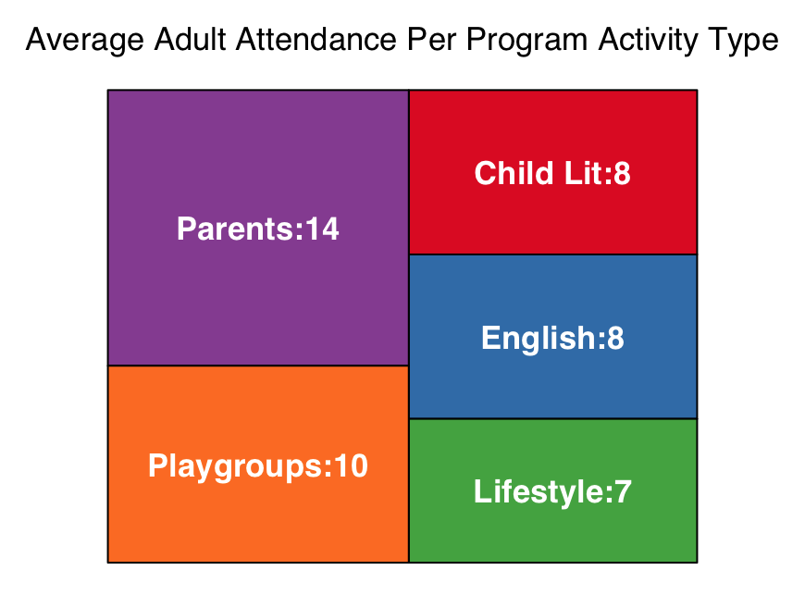
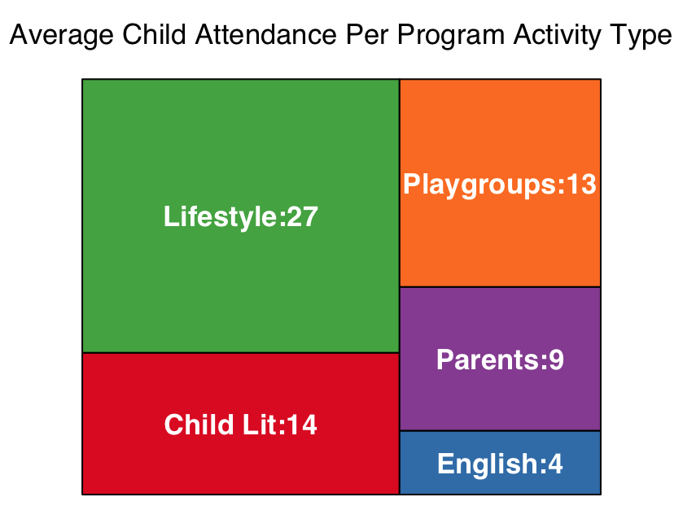
Programmed Activity Attendance by Child / Adult
PA
PA
The below Tree Maps provide a more detailed breakdown of attendance by examining the child and adult attendance by Programmed Activity Type. The following observations can be made:
Lifestyle has a significantly higher rate of attendance by children than adults; even more so than playgroups and child literacy.
As expected, Parents PA have a higher adult attendance than children.
English is also attended at twice the rate by adults than children.
There were a number of outliers identified for this section. Details of these are provided in Ref 5.
SR
SR
EAT
EAT
OOE
OOE

Slide 13
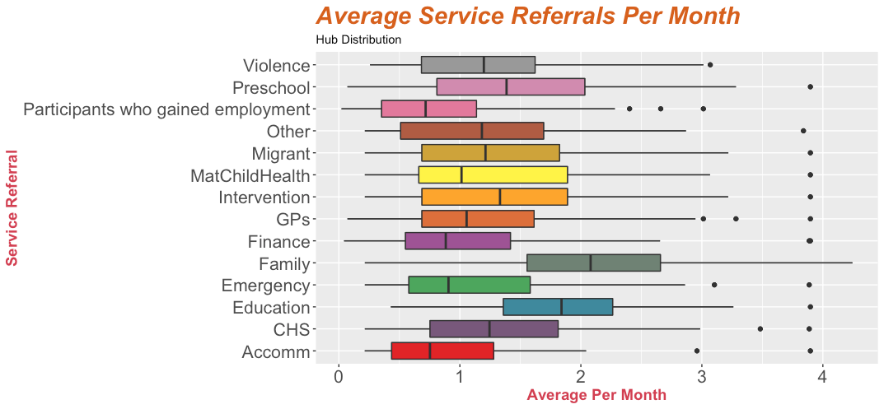
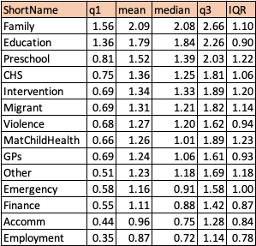
Service Referrals Across CHA
PA
PA
The following chart shows the average and spread of the number of Services Referrals each month, broken down by type:
SR
SR
EAT
EAT
OOE
OOE
Notes:
Speaking Notes:
For each hub we took the average number of Service Referrals made each month for each type.
We then took an average of that number from all the hubs.
The resulting Box Plot gives us an indication of the expected number of Service Referrals made each month by type.
It is clear that service referrals to family and education to be higher than than other types.
It is also worth noting that employment and accommodation referrals tend to be relatively quite low.

Slide 14
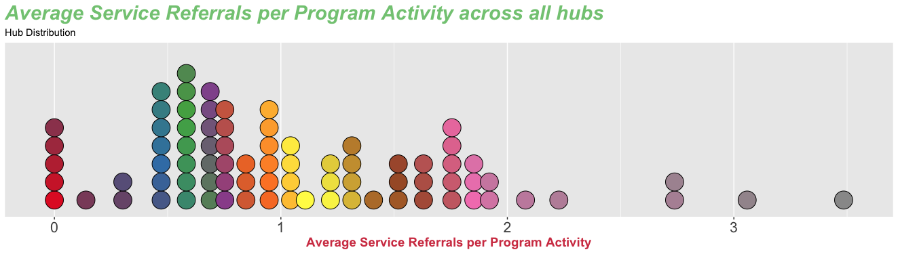
Service Referrals Per PA Across CHA
PA
PA
Understanding how many SRs are made on average per PA can be helpful to know as it is an indication of external engagement.
On average, there are 1.07 Service Referrals per Program Activity.
This SR/PA ratio could be used as a benchmark to help CHA communicate to Hub leaders how they might “tune” their activities:
If the ratio is too low leaders might need to “do” less themselves and focus on partnerships
Too high and the leaders might consider running more programmed activities.
There were a number of outliers identified. Details of these are provided in Ref 6.
SR
SR
EAT
EAT
OOE
OOE
Notes:
Speaking Notes:
Each Hub’s own ratio would need to be considered within the context of their individual circumstances, but could certainly act as a conversation starter.

Slide 15
Service Referrals and Healthy Hubs
PA
PA
Hubs that have a larger number of partnerships may be considered to be more “healthy” than others as the leader is not having to do all the work themselves.
We took the number of different types of Service Referrals made in 2019 as a proxy for the number of partnerships a leader has made and maintained in the community.
The vast majority of Hubs referred people to 13 or 14 different types of service, but there were a few outliers. The following Hubs referred to fewer types of services compared to the majority:
11833 (4 SR types)
14819 (5 SR types)
13765 (10 SR types)
This data could be used to guide conversations with Hub leaders when planning which activities the Hub leader might focus on developing in the near future.
We have provided this data in a separate spreadsheet.
SR
SR
EAT
EAT
OOE
OOE

Slide 16
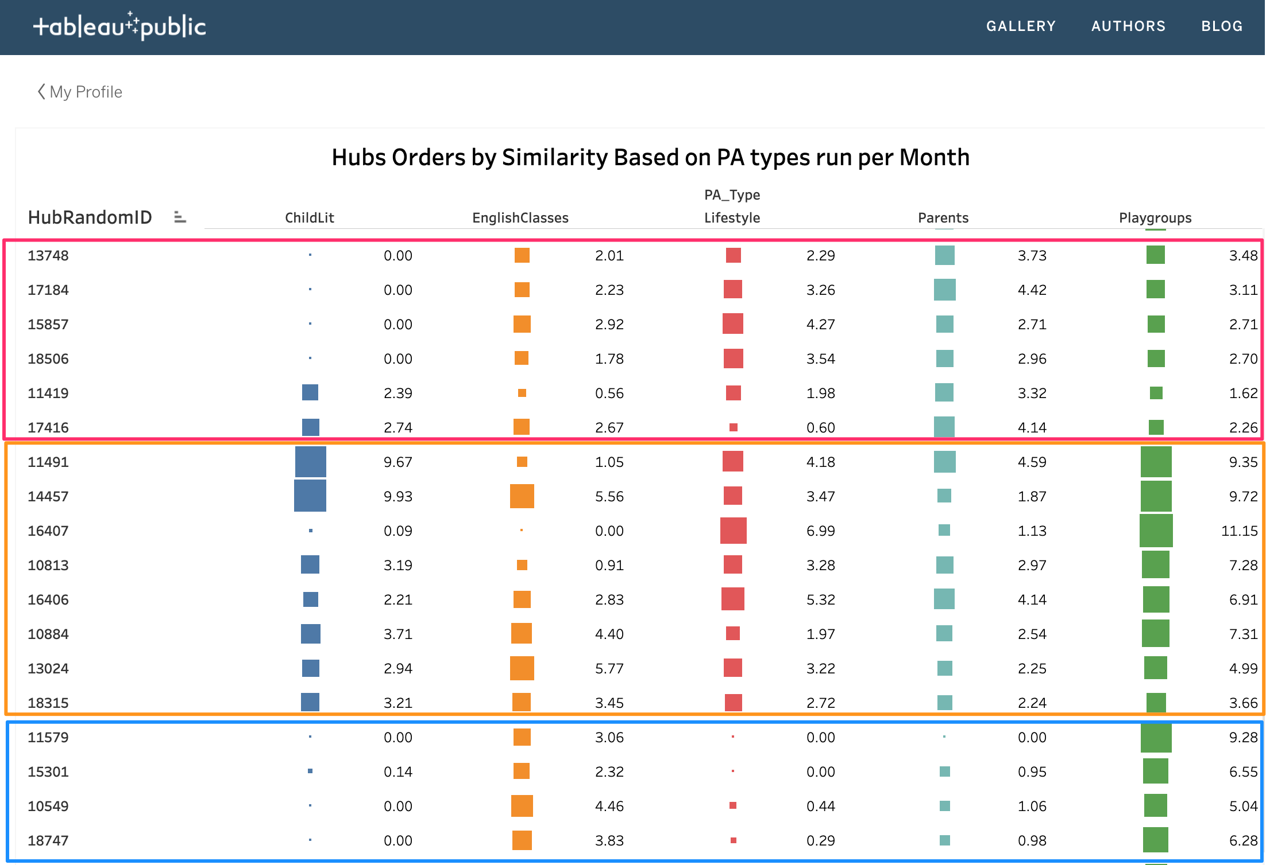
Finding Hub Similarities using Clustering
PA
PA
Hierarchical Clustering helps us find similarities between hubs based on a number of variables.
SR
We performed HC to find similarities between hubs
PA types run
Average PA attendance.
A Tableau Public Plot was created for each of these for CHA to explore (click links).
Each row in plot represents a hub.
The rows in the plot are ordered according to hub similarity based on the values of the PA included.
These plots can help CHA to identify clusters of similar hubs based on the 4 PA types and the metric (numbers run or attendance)
As can be seen on the right, the hubs within the red, orange and blue are more similar to each other to those further away (or in the other squares).
SR
EAT
EAT
OOE
OOE

Slide 17
3.
Summary
What it all means

Slide 18
Summary
Programmed Activities (48%) and Service Referrals (43%) make up the vast majority of activities across hubs on a monthly basis.
Typically a Hub will run approximately 19 Programmed Activities per month
The most popular Program Activities are Playgroups and Parent Engagements.
On average there are 1.07 SR made per PA.
The most common Service Referral made are Family and Education (with 2.1 and 1.8 average referrals per month, respectively).
The typical hub program attendance attendance is 13 children and 9 adults.
Lifestyle is by far the most attended Program Activity on a month basis.
Lifestyle has a significantly higher rate of attendance by children than adults; even more so than playgroups and child literacy.
Some Hubs have a disproportionate number of Service Referrals - SRs make up more than 50% of all activities for 14 Hubs.
Others Hubs have little to no Service Referrals (5 hubs).
One Off Events have been initiated in more recent times (recorded from July 2019).

Slide 19
Recommendations
As we were working on this project, we have identified a number of recommendations:
Provide guidance to the Hub leaders to help them input relevant data:
Clarity on what is a Hub activity and on activity types For example, Hub #18922 appeared to be recording a school-based event (perhaps assembly or a breakfast club) with ~500 participants each Monday morning and once-a-year parent engagement events with 1000-3500 participants each year, which skewed some data considerably
Understanding Programmed Activities with no participants Our analysis excluded these records, but it may be useful for CHA if activities that had no participants attend were recorded differently to activities that were cancelled by the Hub.
Define some metrics of success:
It is clear that defining success is difficult given the nature of the work CHA staff do.
To measure improvement it is still vital to have some metric to use as measure.
There were a number suggested through this presentation around internal and external engagement.

Slide 20
Recommendations
Use a database instead of a spreadsheet:
The spreadsheet provided is obviously trying to capture different information about different things using the same columns.
Some of these columns do not apply to all data entities. For example , “number of families participating in the Hub” is not really a Service Referral. Hence many of the columns do not apply to it.
A database allows users to capture relevant info for each and to establish relationships between the various data entities. For example, PA may be associated with SRs.
This would allow for more accurate data capture, better analytics, reporting and decision making.
Create linkages between entities
Even if you are not going to use a Database, think of the relationships between the data entities (for example an SR might be an outcome of a PA). Try to capture these relationships (for example Parent PA on an SR).

Slide 21
Bantry
Cecilia Azcurra
Ronen Becker
Simon Davies
Yifan Lin

Slide 22
4.
References
Outlier details provided

Slide 23
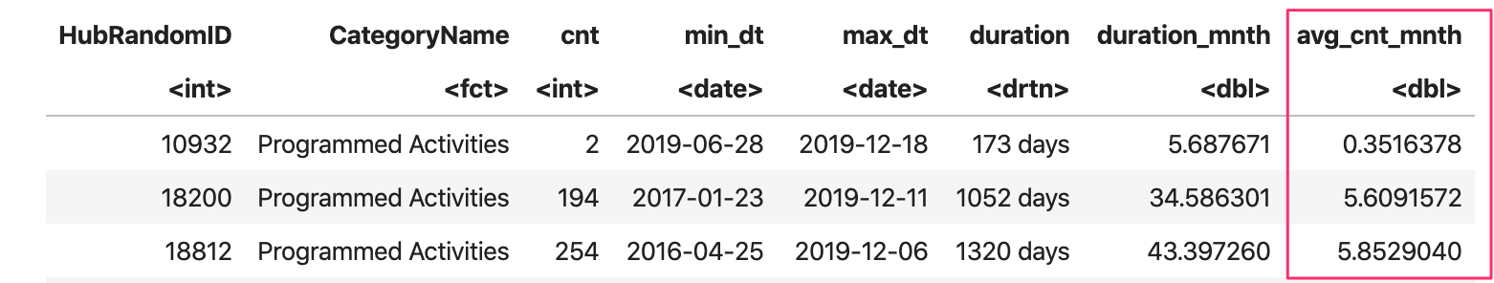
Reference 1 - Outliers
Hubs with 5 or less PA per month

Slide 24
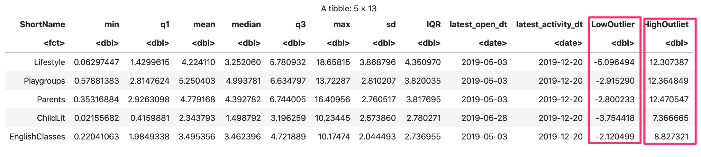
Reference 2 - Outliers
Hubs PA per month by Type Outlier Ranges

Slide 25
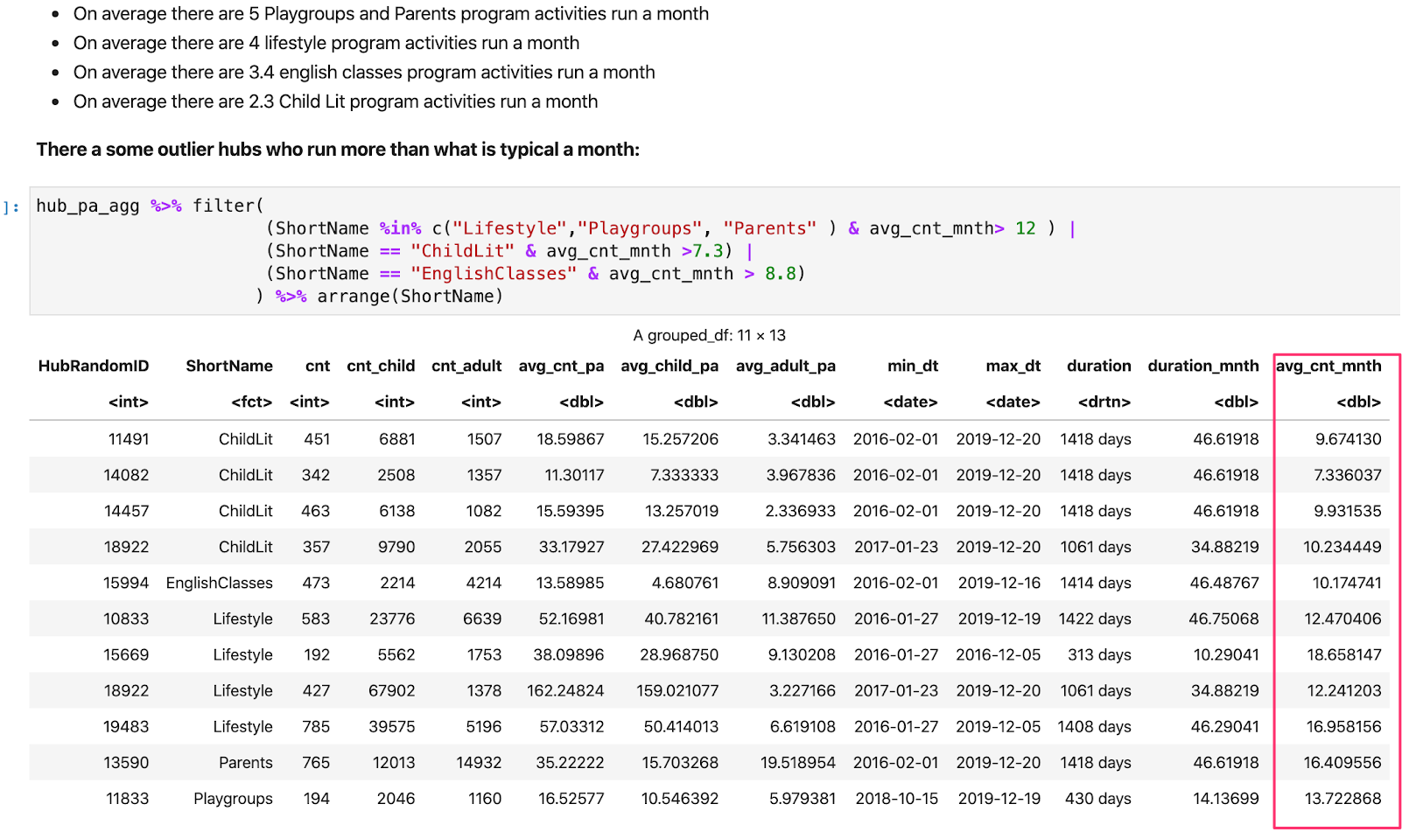
Reference 2 - Outliers
Hubs PA per month by Type Outliers

Slide 26
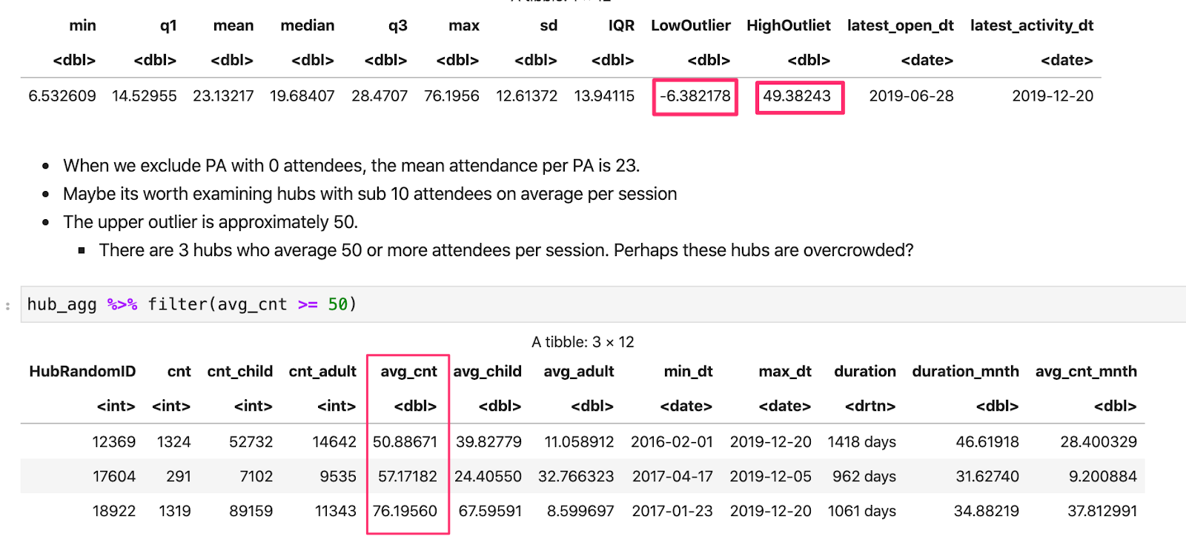
Reference 3 - Outliers
Hubs PA Attendance Outliers:

Slide 27
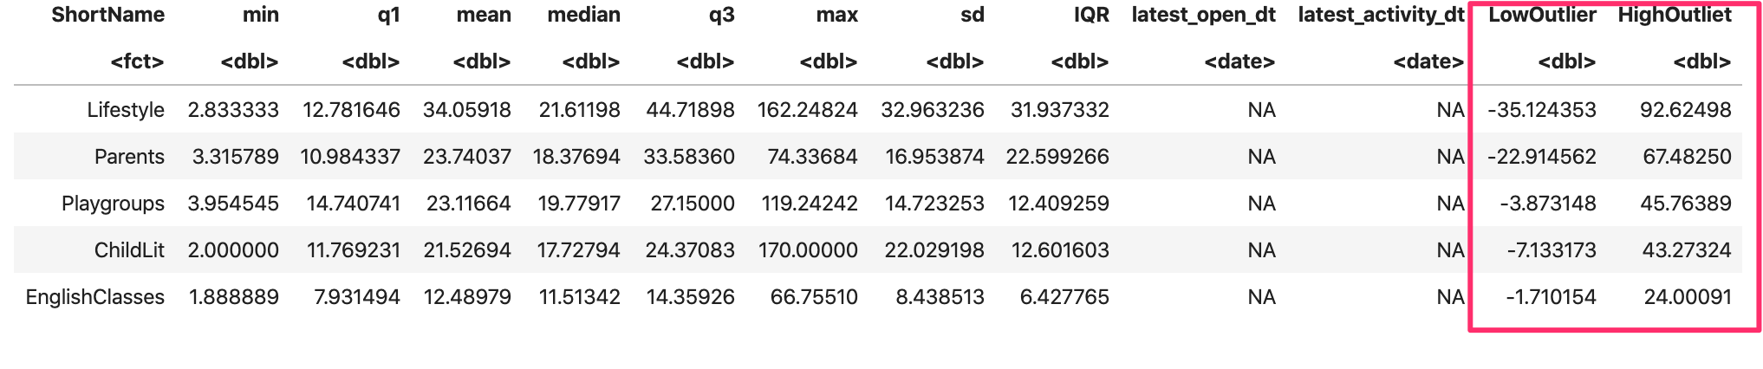
Reference 4 - Outliers
Hubs PA Attendance Outlier Range:

Slide 28
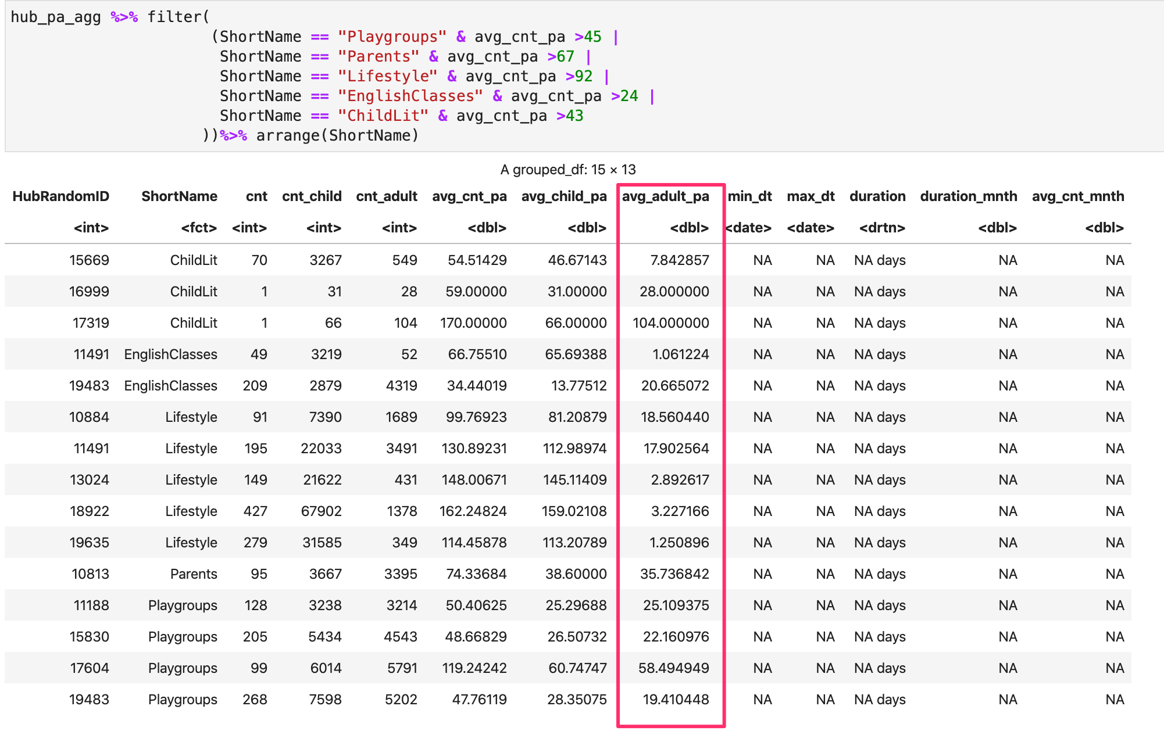
Reference 4 - Outliers
Hubs PA Attendance Outliers:

Slide 29
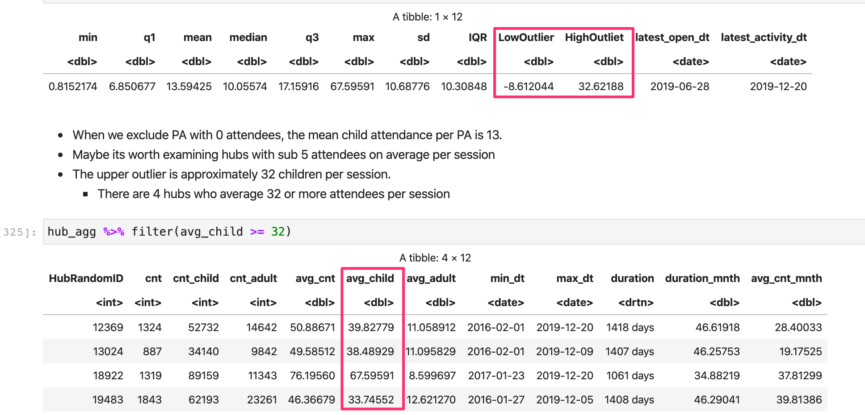
Reference 5 - Outliers
Hubs Child / Adult Attendance Outliers
Child Outliers:

Slide 30
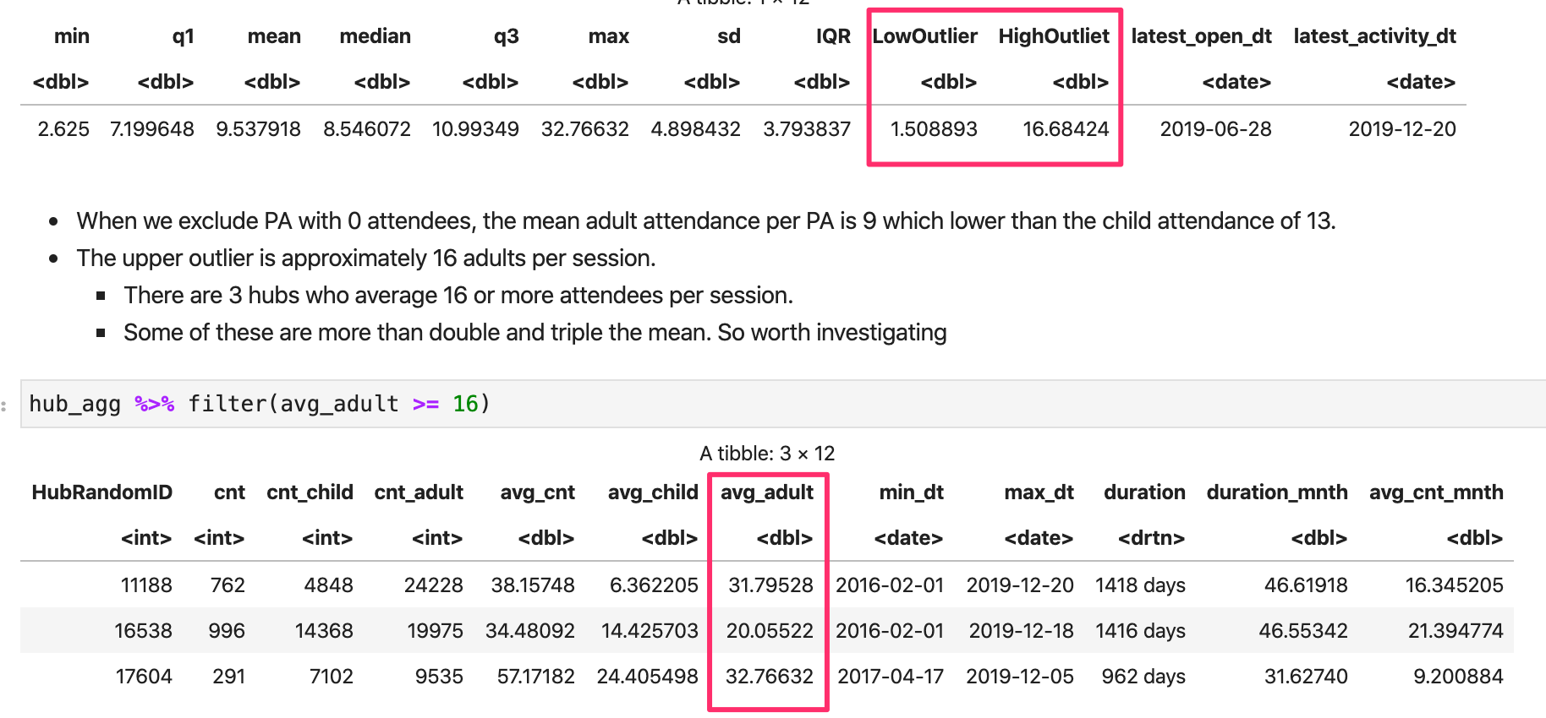
Reference 5 - Outliers
Hubs Child / Adult Attendance Outliers
Adult Outliers:

Slide 31
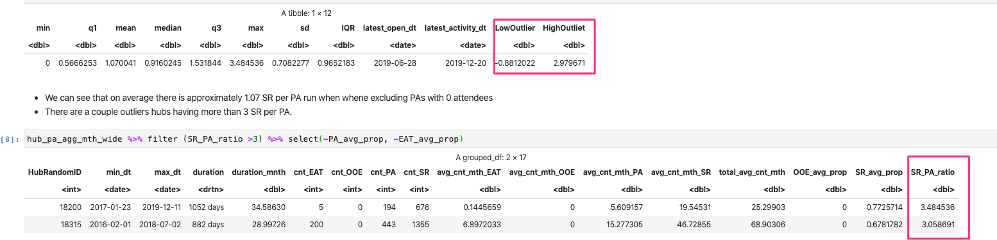
Reference 6 - Outliers
SR / PA Ratio Outliers:

Slide 32
Bantry
Cecilia Azcurra
Ronen Becker
Simon Davies
Yifan Lin

